Slide 1

Senior Project Hub
Abdulrahman Alshehri Fawaz Alghamdi Supervised by: Dr.Wafi Bedewi

Slide 2

Introduction
Senior Project Hub is a unified web platform that connects FCIT senior students with professors, streamlining idea submission, group formation, and project communication in one place.

Slide 3
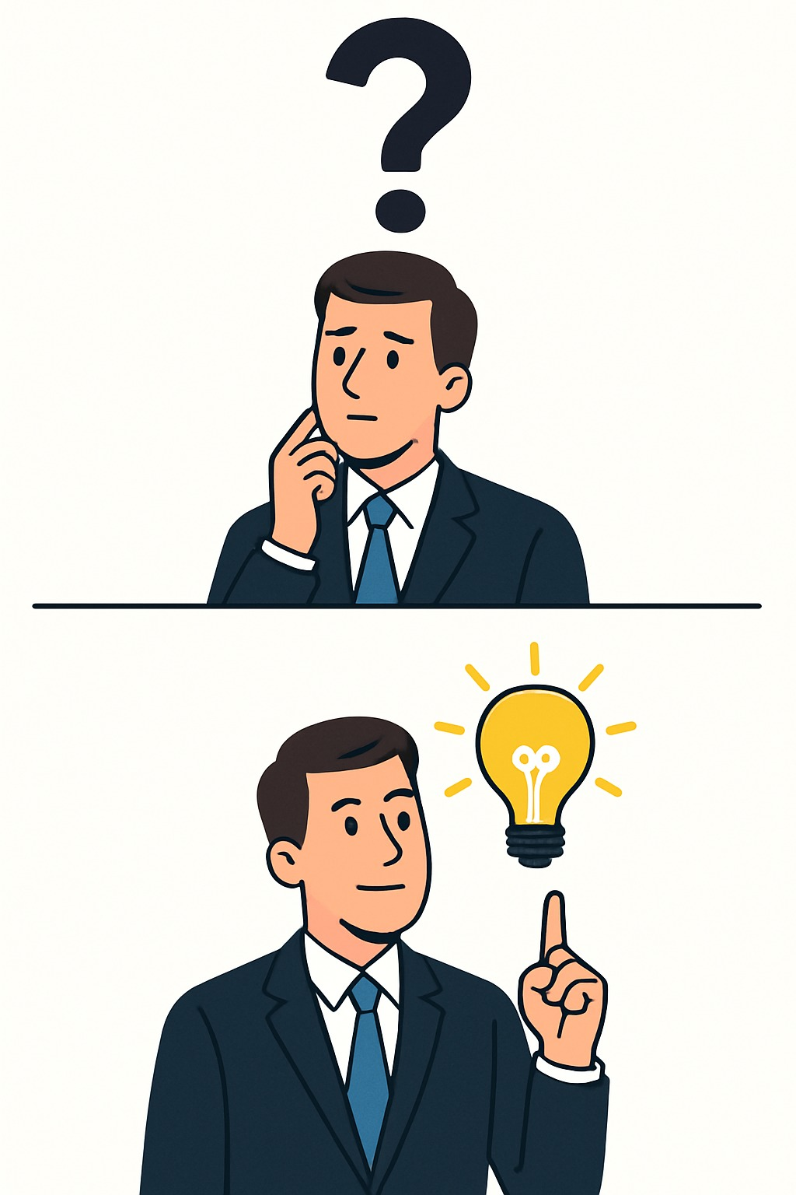
Problem Statement
Currently, project details are scattered across emails, office visits, and external forms, making it hard for students to find opportunities, form groups, and track their application status, which leads to delays and lost data.

Slide 4
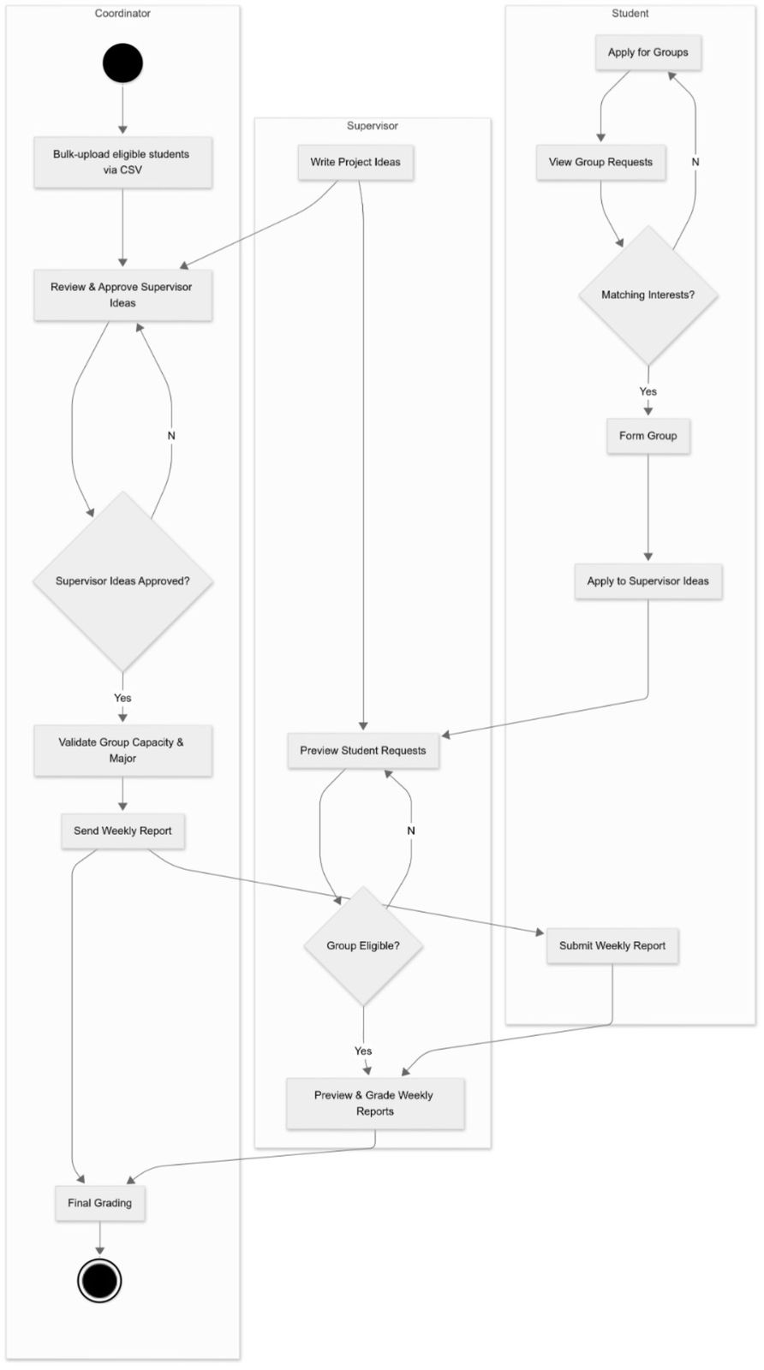
System Structure
The system has student, supervisor, and coordinator portals for managing projects, groups, and supervision. Includes secure signup/login, automated weekly reports, email notifications, and efficient database operations

Slide 5

Implementation
The Senior Project Hub was built using ASP.NET Web Forms with C# code-behind, supported by a SQL Server database. Backend logic integrates SQL queries and C# methods to manage project workflows.

Slide 6
Testing of the System
Testing types
Unit tests
Integration tests
User-acceptance tests
Tested features
Signup validation
Group applications
Idea submission
Weekly reports
Grading
Issues found
Group-ID reuse
UI refresh glitches
Missing timestamps

Slide 7
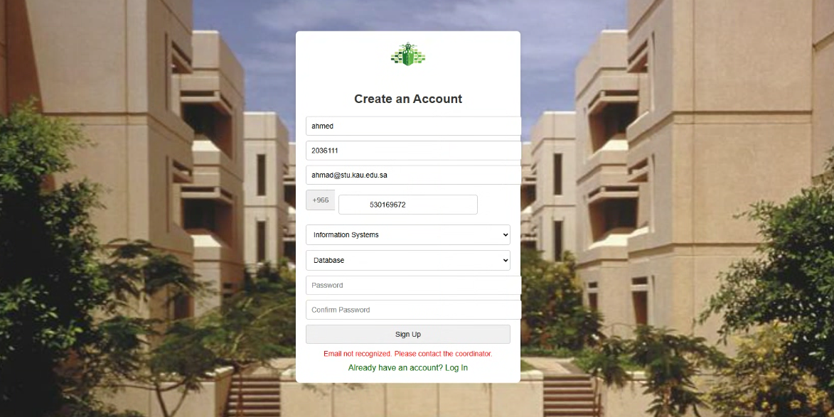
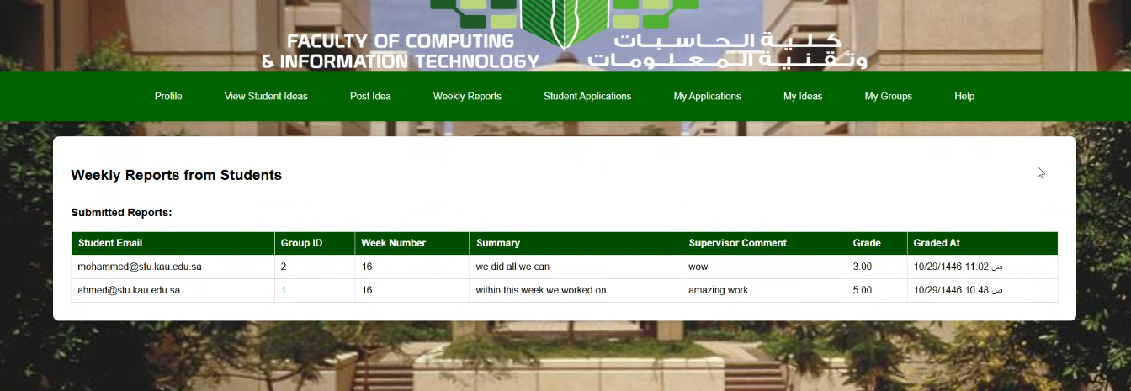
Testing of the System
Signup validation:
Weekly reports:

Slide 8

System Demo

Slide 9

Project Limitation & Future Work
Uses SMTP emails, lacks real-time updates
No SSO, no central logging, no mobile support
Future upgrades: SSO, push alerts, mobile app, analytics, AI matching across KAU

Slide 10
Conclusion
Senior Project Hub centralizes and automates project workflows, improving accessibility, transparency, and collaboration, and lays the groundwork for broader adoption and new functionality.

Slide 11
References
UROP Frameworks: MIT UROP (2024), Cambridge UROP (2021)
Portal Designs: Final‐year project portal (Ademola et al. 2013), Innovation Portal (Hughes & Brunelle 2018), IS group projects (Mamat 2004)
Research & Collaboration Portals: Online research portal (Rodafinos et al. 2018), Collaboration portal (Khastkhodaardekani 2015)
Technical Handbooks: Frontend Developer Handbook (Lindley 2017), Modern Backend Technologies (Sharma et al. 2024)
Web Development Guides: HTML (Castro 2003), CSS (Meyer 2006), JavaScript (Flanagan 2011), SQL (Beaulieu 2009), ASP .NET Core (Lock 2023)

Slide 12
Thank you
Abdulrahman Alshehri Fawaz Alghamdi Supervised by: Dr.Wafi Bedewi

